Slide 1

Repair Management Services Dashboard
By Clint Jansson
5/18/2019
.

Slide 2
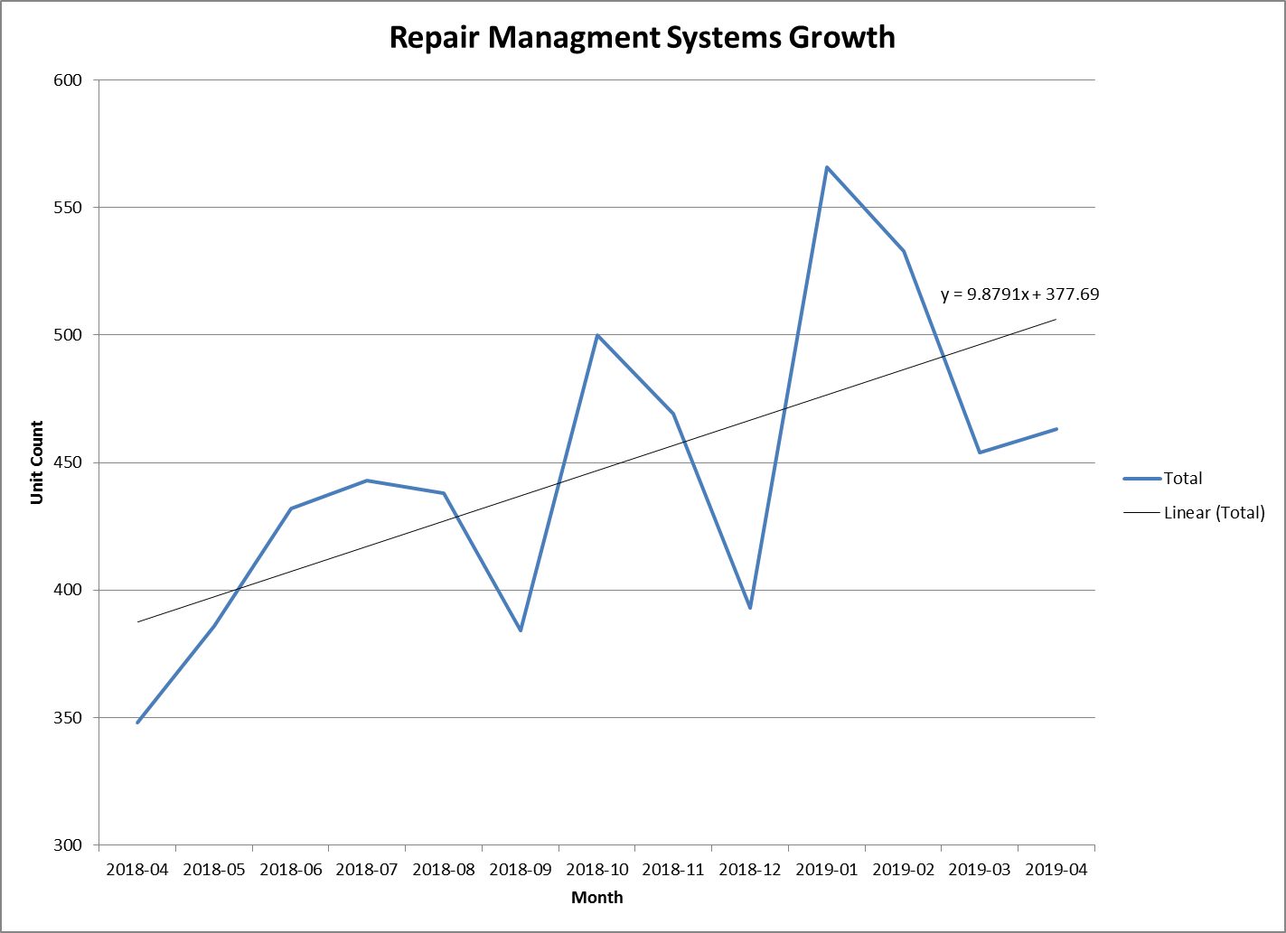
RMS Dashboard
SITE Returns
RMS is an Aerospace service provider to manage supplier repairs
We have grown from 6 people in May 2018 to 16 current day.
We manage repairs so our volumes are tied to failure rates and customer returns.
Due to New Programs we are seeing a 10 unit increase Month over month.

Slide 3
RMS Dashboard
Platform Analysis
RMS is seeing a growth of 3 unit per month on legacy programs
The newest program GTF is seeing a growth of 6 units per month.

Slide 4
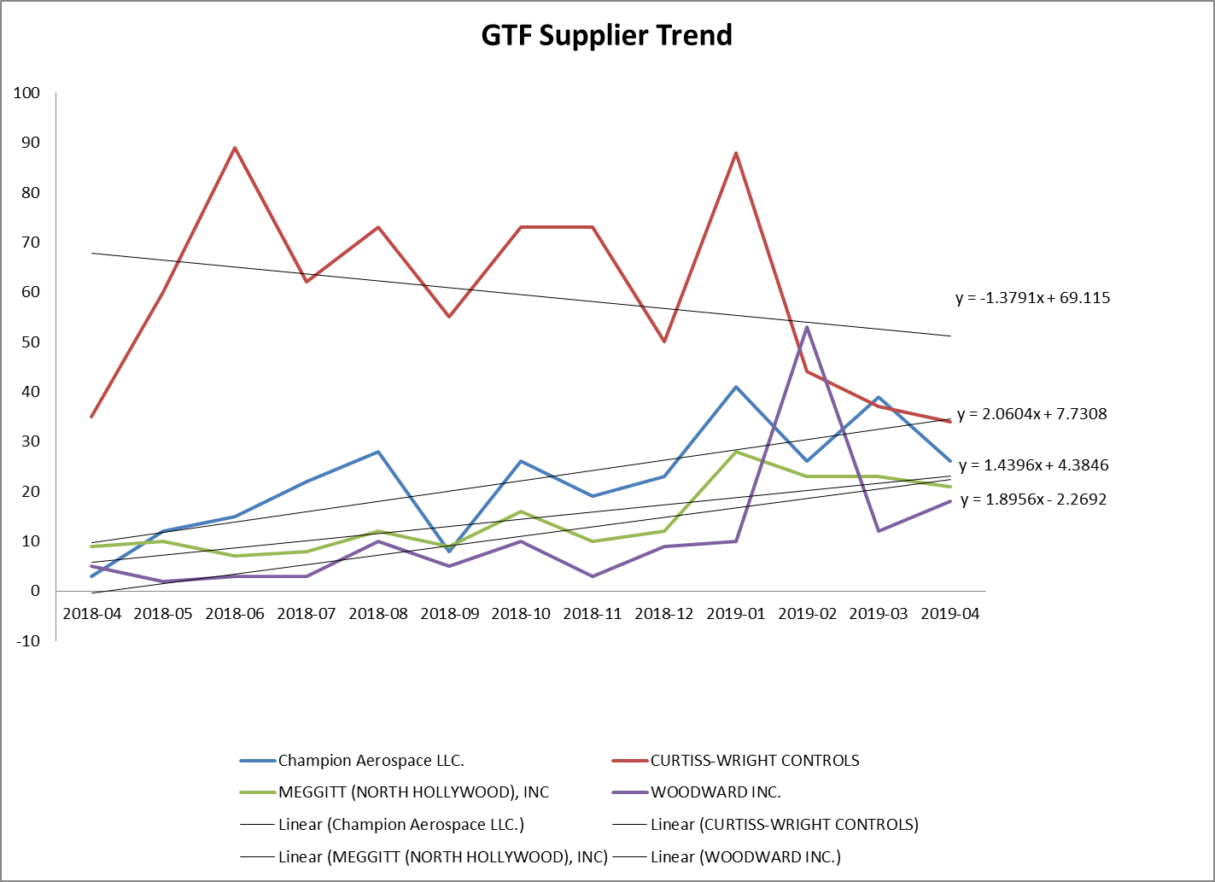
RMS Dashboard
Top GTF supplier volume
Champion, Meggitt and Woodward are seeing the largest increase in volume accounting for 45% of the total volume increase for RMS
Curtiss Wright is decreasing as they are nearing the end of a retrofit.

Slide 5
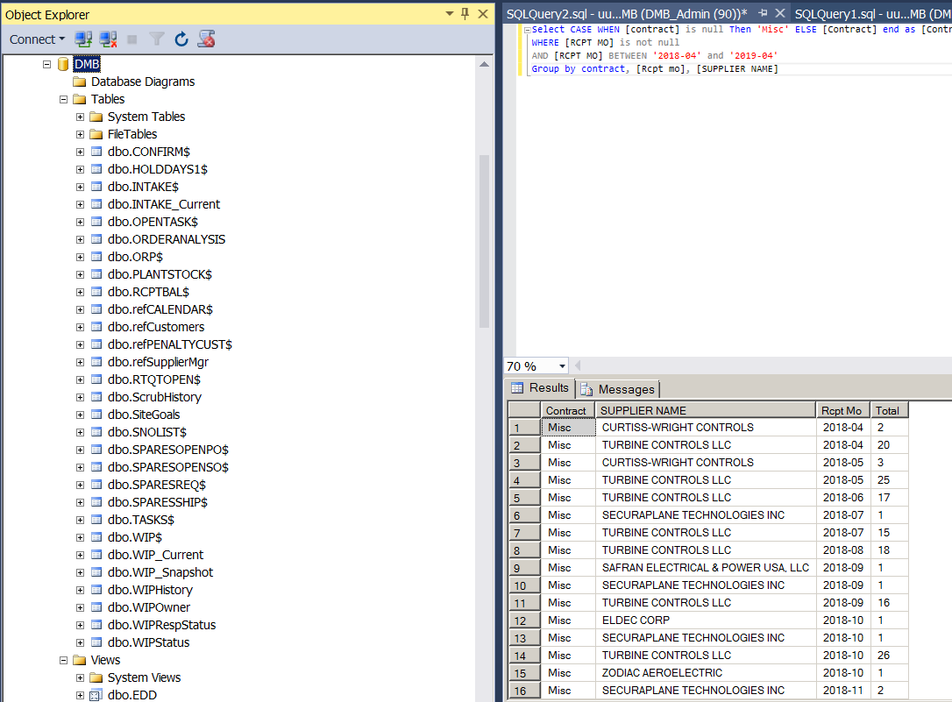
RMS Dashboard
SQL Server
All Data is extracted from the company’s ERP system.
Using VBA to extract, and load to the SQL database,
R studio and Excel to present and analyze data.
Created new backlog tracking protocol to support this project.

Slide 6
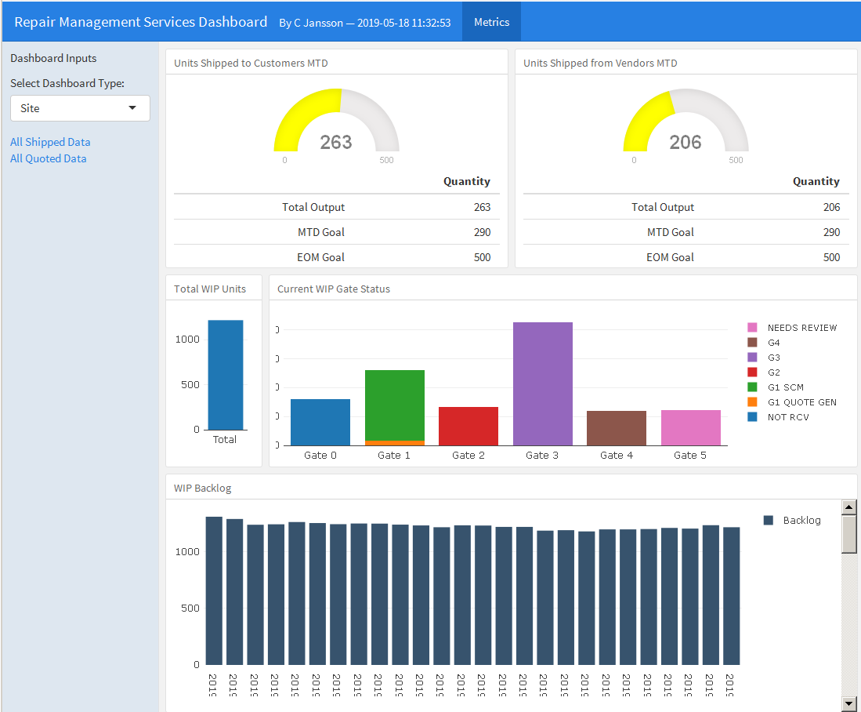
RMS Dashboard
R Studio Dashboard
R studio dashboard designed to manage and show our productivity for
Shipments
WIP ( Work in Progress)
Backlog over time to show if capacity is being met.
Interactive for each of the team member to the items they are accountable for and track the overall performance to ensure we are staffed to meet the increasing demand.

Slide 7
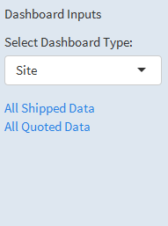
RMS Dashboard
Interactive
View output and success of each team member and overall sit.

Slide 8
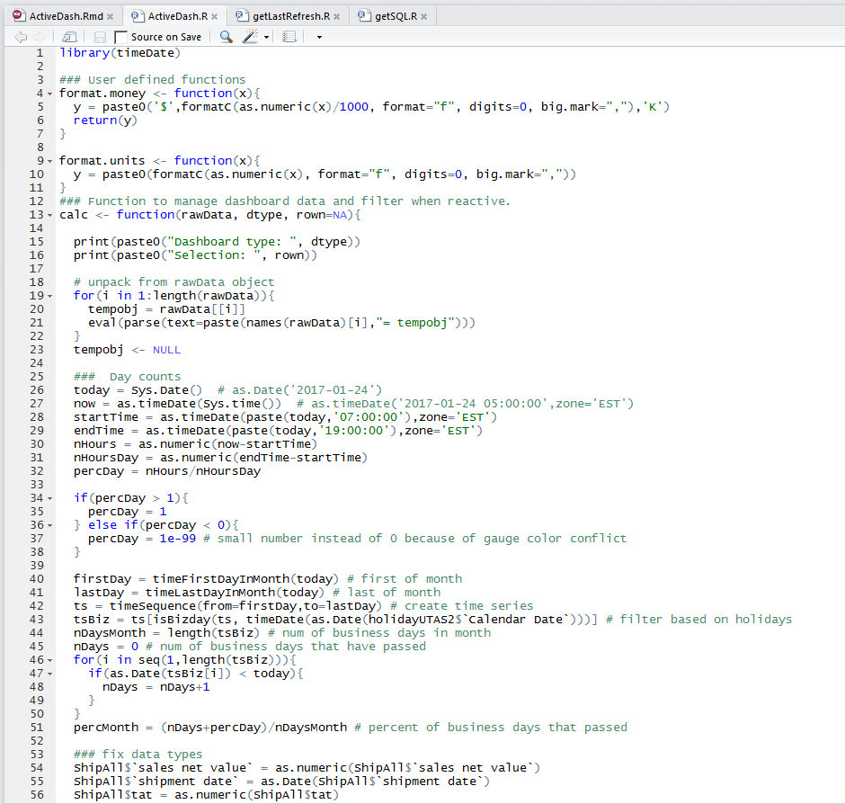
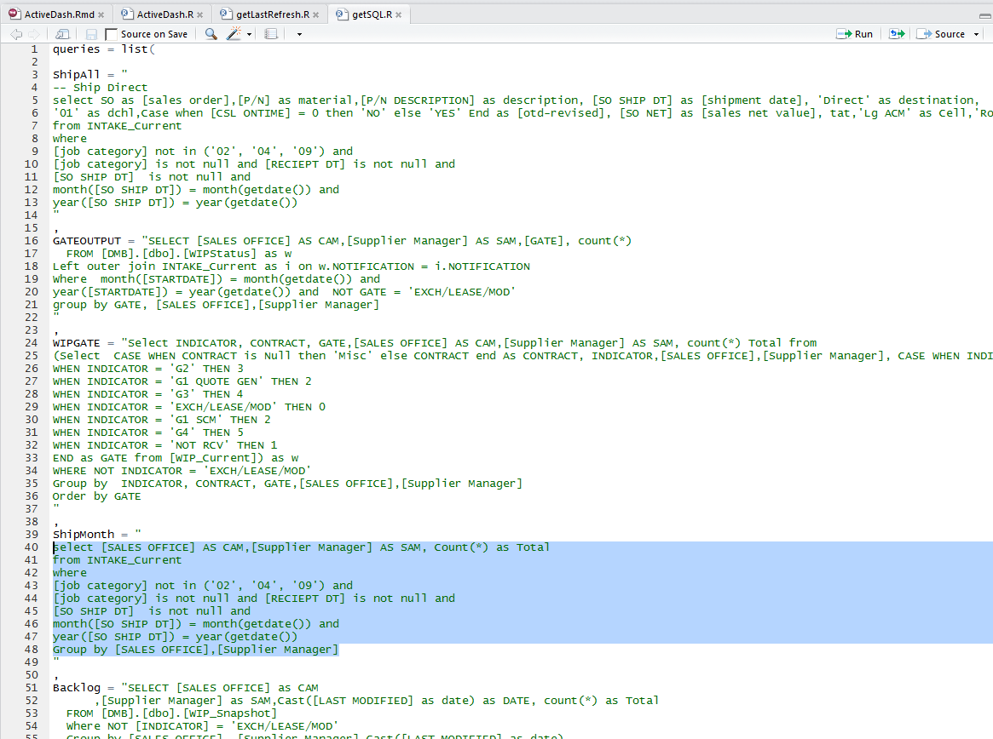
R Code

Slide 9
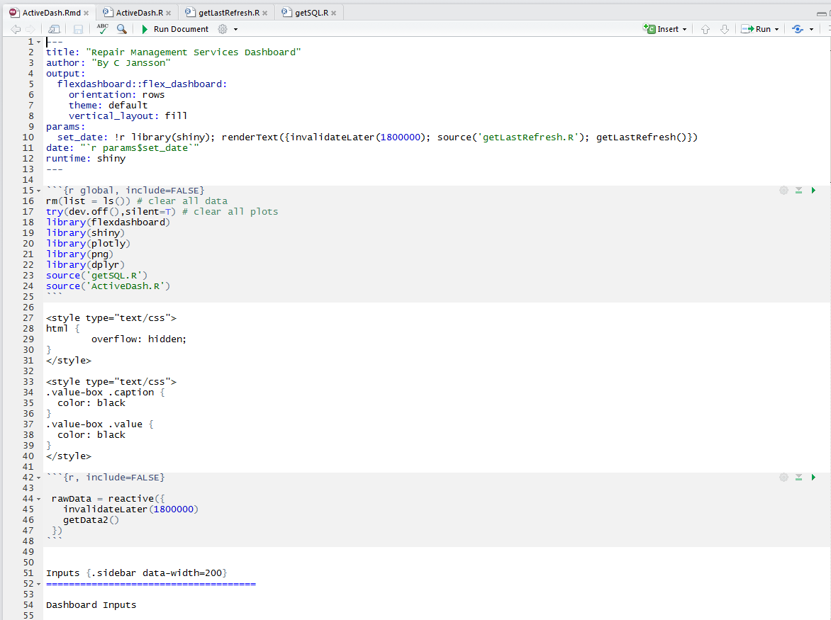
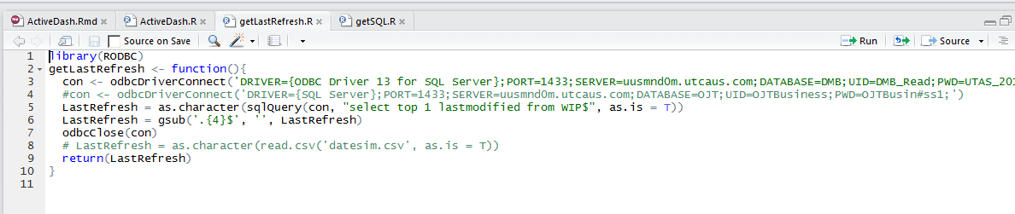
R Code

